Slide 1
Tonight’s class
Guest Lecture
Quiz
Project
Object Initialization
Clone
Singleton
Factory Method
Abstract Factory
Flyweight pattern

Slide 2
Guest lecture
Kevin Duber
CTO and Co-Founder of ADSHIFT
Real World Software Engineering

Slide 3
Quiz

Slide 4
Project
http://fpl.cs.depaul.edu/jriely/450/lectures/class-07.html#slide010
http://fpl.cs.depaul.edu/jriely/450/notes/notes-final-project-015.html

Slide 5
Default values in java
In Java, different types have different values when they’re not initialized.
Reference types are null
Value types are some variation of 0 (Boolean is false, byte, short, int, etc. are 0, char is the null terminator (/u0000)

Slide 6
Subclass constructors
(demo)

Slide 7
Object lifespan
In Java, everything are references. When you create an object, an object is created in the heap and you are given a pointer which contains the address in memory where the object is stored at. Java will keep track of how many pointers are pointing at an object. When the count hits 0, the object will get deleted by the Garbage Collector, which will free up that space for future use by the program.

Slide 8
Object lifespan and cloning
So if you have a list that contains a pointer to some object o1, and you clone o1, you now have two different objects in the heap (as opposed to if you were to just do Object o2 = o1).

Slide 9
Cloning
When you clone, the following should be true:
x.clone() != x
x.clone().getClass() == x.getClass()
x.clone().equals(x)
The last won’t necessarily be true, but it probably should be true.

Slide 10
Cloning vs Deep Copying
Cloning copies the current values of the objects. If an object that’s being cloned has a pointer to a child object, the clone will just copy the pointer to that child object.
If you want a complete copy of the object and its child objects, you will need to do a deep copy. This will require you to also call a deep copy on the child objects.

Slide 11
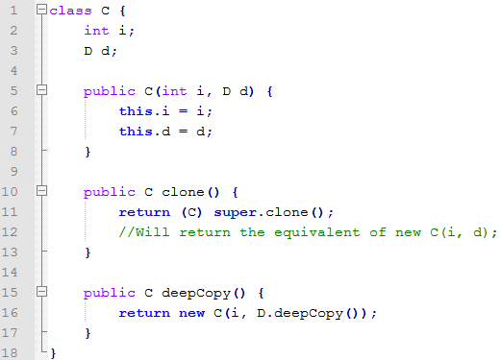
Cloning vs. Deep Copying
(draw diagram on board)

Slide 12
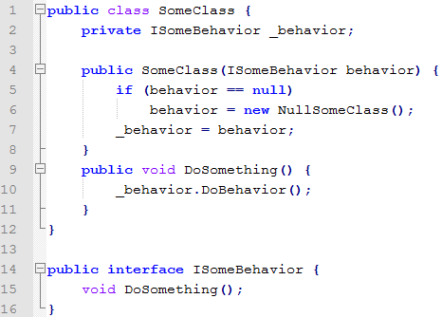
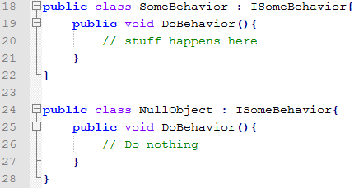
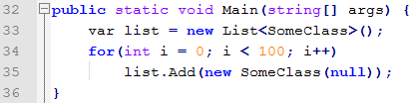
Let’s say you have the following situation:
s
Notes:
public class SomeClass {
private ISomeBehavior _behavior;
public SomeClass(ISomeBehavior behavior) {
if (behavior == null)
behavior = new NullSomeClass();
_behavior = behavior;
}
public void DoSomething() {
_behavior.DoBehavior();
}
}
public interface ISomeBehavior {
void DoBehavior();
}
public class SomeBehavior : ISomeBehavior{
public void DoBehavior(){
// stuff happens here
}
}
public class NullObject : ISomeBehavior{
public void DoBehavior(){
// Do nothing
}
}

Slide 13
What’s one issue with this design?
s
Notes:
public class SomeClass {
private ISomeBehavior _behavior;
public SomeClass(ISomeBehavior behavior) {
if (behavior == null)
behavior = new NullSomeClass();
_behavior = behavior;
}
public void DoSomething() {
_behavior.DoBehavior();
}
}
public interface ISomeBehavior {
void DoBehavior();
}
public class SomeBehavior : ISomeBehavior{
public void DoBehavior(){
// stuff happens here
}
}
public class NullObject : ISomeBehavior{
public void DoBehavior(){
// Do nothing
}
}

Slide 14
Lots of NullSomeClass instances
s
Notes:
public class SomeClass {
private ISomeBehavior _behavior;
public SomeClass(ISomeBehavior behavior) {
if (behavior == null)
behavior = new NullSomeClass();
_behavior = behavior;
}
public void DoSomething() {
_behavior.DoBehavior();
}
}
public interface ISomeBehavior {
void DoBehavior();
}
public class SomeBehavior : ISomeBehavior{
public void DoBehavior(){
// stuff happens here
}
}
public class NullObject : ISomeBehavior{
public void DoBehavior(){
// Do nothing
}
}

Slide 15
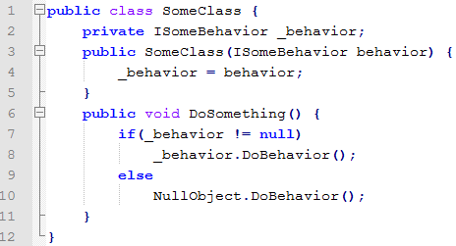
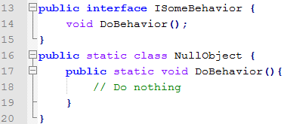
One way to reduce the footprint is to use a static class

Slide 16
But this requires null checks everywhere

Slide 17
Further, with a static class, you can’t pass a NullObject as an argument to methods

Slide 18
So what can we do?
(demo)
Notes:
public class SomeClass {
private ISomeBehavior _behavior;
public SomeClass(ISomeBehavior behavior) {
_behavior = behavior;
}
public void DoSomething() {
if(_behavior != null)
_behavior.DoBehavior();
else
NullObject.DoBehavior();
}
}
public interface ISomeBehavior {
void DoBehavior();
}
public static class NullObject {
public static void DoBehavior(){
// Do nothing
}
}
public class SomeBehavior : ISomeBehavior{
public void DoBehavior(){
// stuff happens here
}
}

Slide 19
Singleton pattern
This is called the Singleton pattern. Singleton is when you have a single instance of an object and other instances can’t be initialized. The single instance can be accessed statically.

Slide 20
Singleton uml
(draw uml on board)

Slide 21
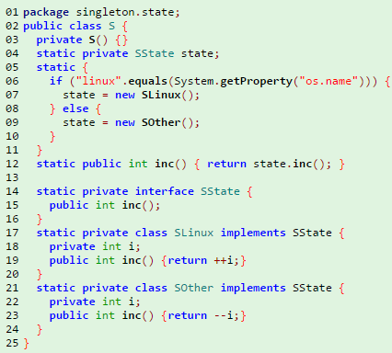
There are several ways of using Singleton
One way is to keep the single instance private and limit access to certain methods

Slide 22
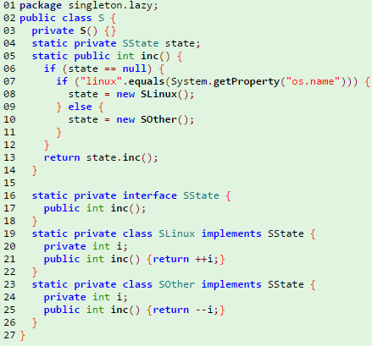
Lazy loading
Like our first example, only load the single instance upon first access and then cache the result.

Slide 23
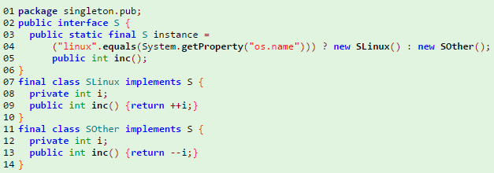
Public read-only instance
Make the instance public, but make sure it’s read-only!

Slide 24
Singleton pattern
Make sure you don’t have any cloning or copying functions. You don’t want to accidentally allow the creation of a new instance.

Slide 25
Factories
We’ve already talked about the Static Factory pattern. It has a couple shortcomings. When you have two related objects (like a collection and it’s iterator), you might want the first object to be in charge of creating the specific second object (ArrayList creates an ArrayListIterator). Static factory can’t handle this situation without the client being aware of its type.

Slide 26
Factory method pattern
(demo)
Notes:
public class ArrayList {
}
public class LinkedList {
}
public class ArrayListIterator : IIterator {
}
public class LinkedListIterator : IIterator {
}

Slide 27
Abstract factory
Sometimes there might be a whole suite of related classes, that each need factories. In this case, use an Abstract Factory.

Slide 28
Abstract Factory demo
(demo)
Notes:
public interface ICarFactory {
IEngine CreateEngine();
ICarBody CreateCarBody();
IWheels CreateWheels();
}

Slide 29
What if cars were all the same size/speed?
If all cars were the same size/speed, what would be the differentiating factor between those cars?

Slide 30
What if cars were all the same size/speed?
If this was the case, could we reduce the amount of memory in our application? Hint: think about the saying “Encapsulate what varies”.

Slide 31
We can encapsulate the parts that don’t change
Color and length don’t change. Position and velocity do.
In this case, we’re encapsulating what doesn’t vary. We can put the parts that do vary into their own object with a reference to the one object that doesn’t vary. This is called the Flyweight pattern.

Slide 32
Flyweight demo
(demo)
Notes:
public class Car {
int position;
int currentVelocity;
Color color;
int length;
}

Slide 33
Flyweight demo 2
The non-flyweight objects might vary slightly too – the idea is there is some shared information.
You might, for instance, have a car (with a length of 8 and a color of Blue), an SUV (with a length of 10 and a color of Green), and a Truck (length of 25, color of Red). Even though these three objects are different, there could be dozens of instances of each.
(demo)

Slide 34
Source Control

Slide 35
Visio Demo

